Slide 1




How GDP per Capita Influence Quality of Life & Happiness
Data Visualization
Group 8: Yu Ming Chen & Chunran Chen

Slide 2


Hypothesis & Datasets
Hypothesis:
The country’s GDP will affect the happiness and quality of life of the citizens. As a country’s GDP per capita increases, the quality of life and citizens’ happiness also increases.
Life Quality:
https://www.kaggle.com/datasets/ahmedmohamed2003/quality-of-life-for-each-country/data
GDP of Countries:
https://www.kaggle.com/datasets/darrylljk/better-life-index-2024-life-satisfaction
Happiness:
https://www.kaggle.com/datasets/unsdsn/world-happiness

Slide 3
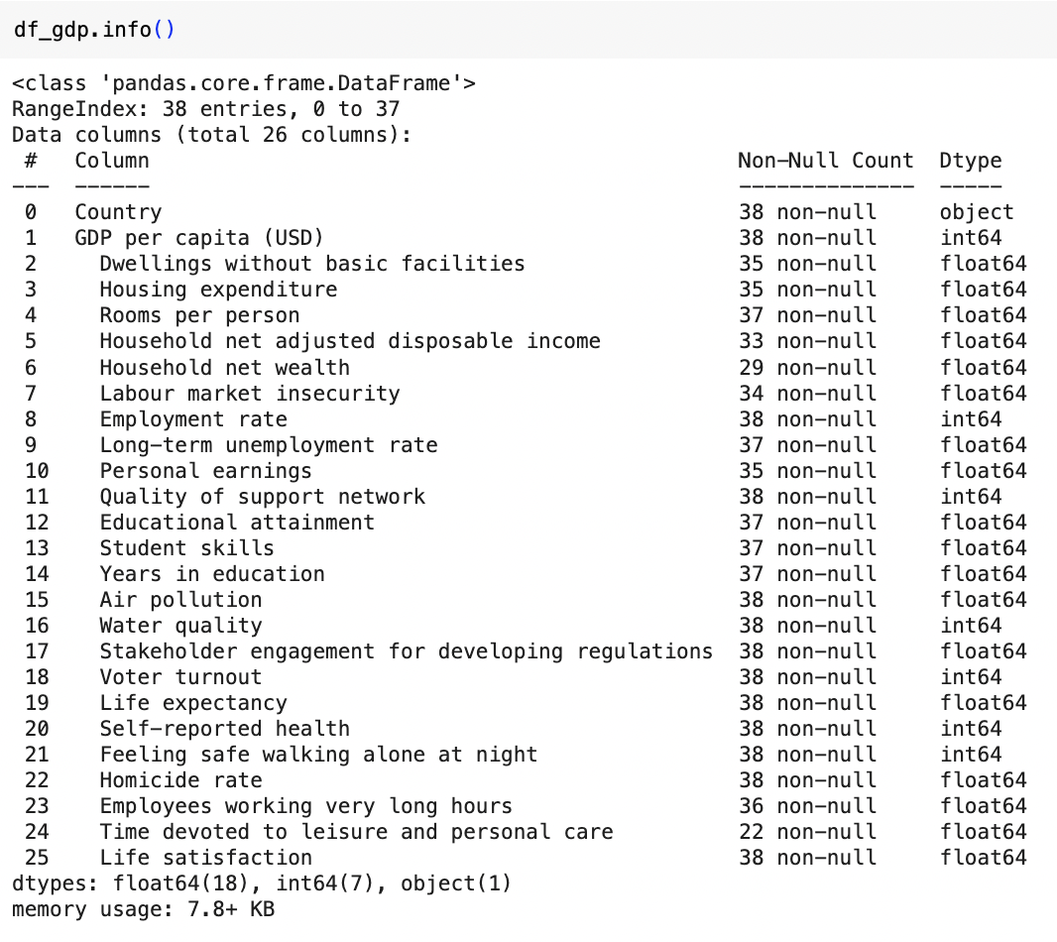
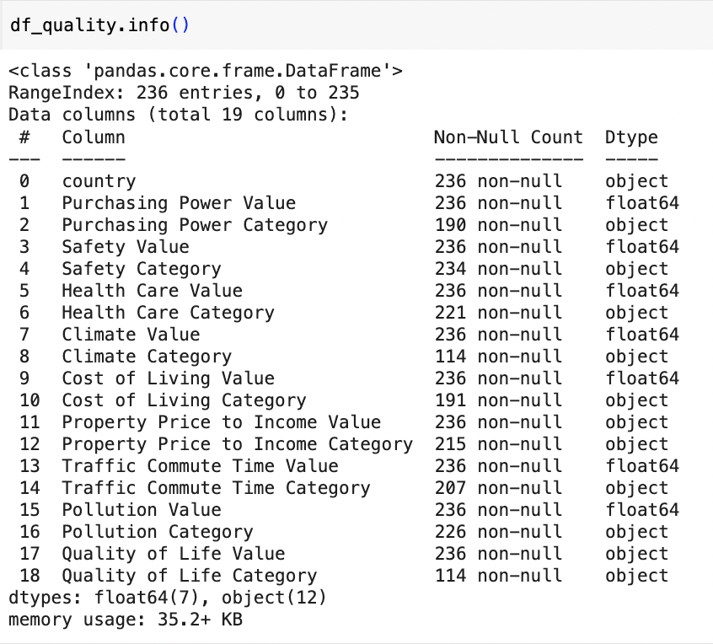
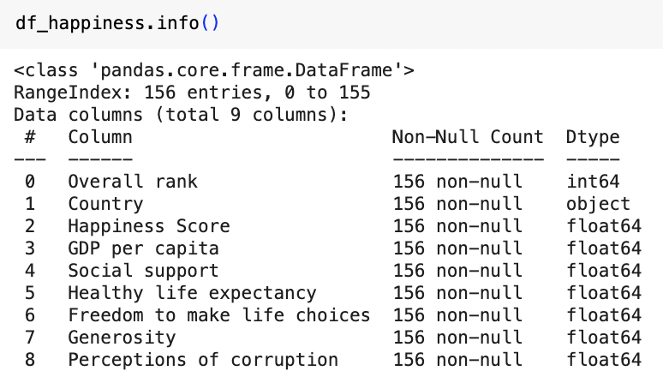
Dataset Descriptions
Life Quality:
236 Rows
19 Columns
GDP of Countries:
38 Rows
26 Columns
Happiness:
156 Rows
9 Columns
Tools Used:
Python
Tableau
Excel

Slide 4


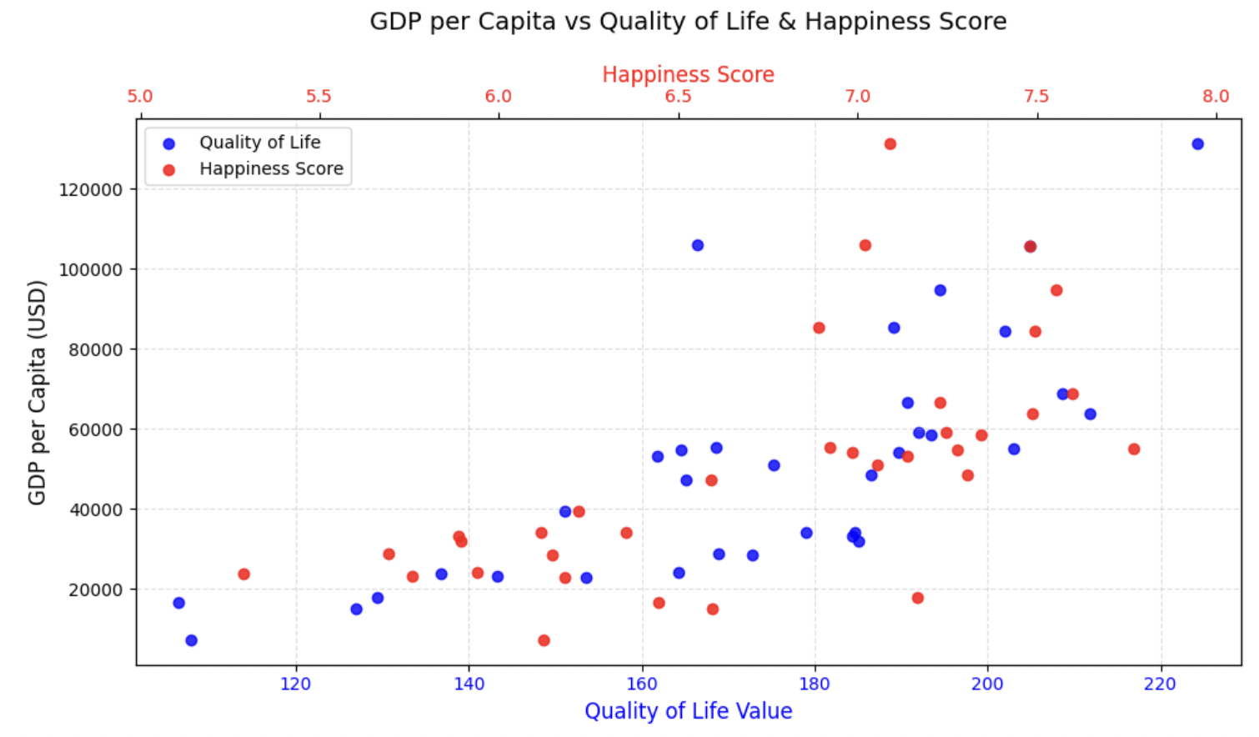

Correlation of GDP per Capita with life Quality & Happiness Score
GDP per capita has a strong correlation with happiness score & quality of life
Outlier points are countries with high GDP but low life quality & happiness score or low GDP with high life quality & happiness score

Slide 5
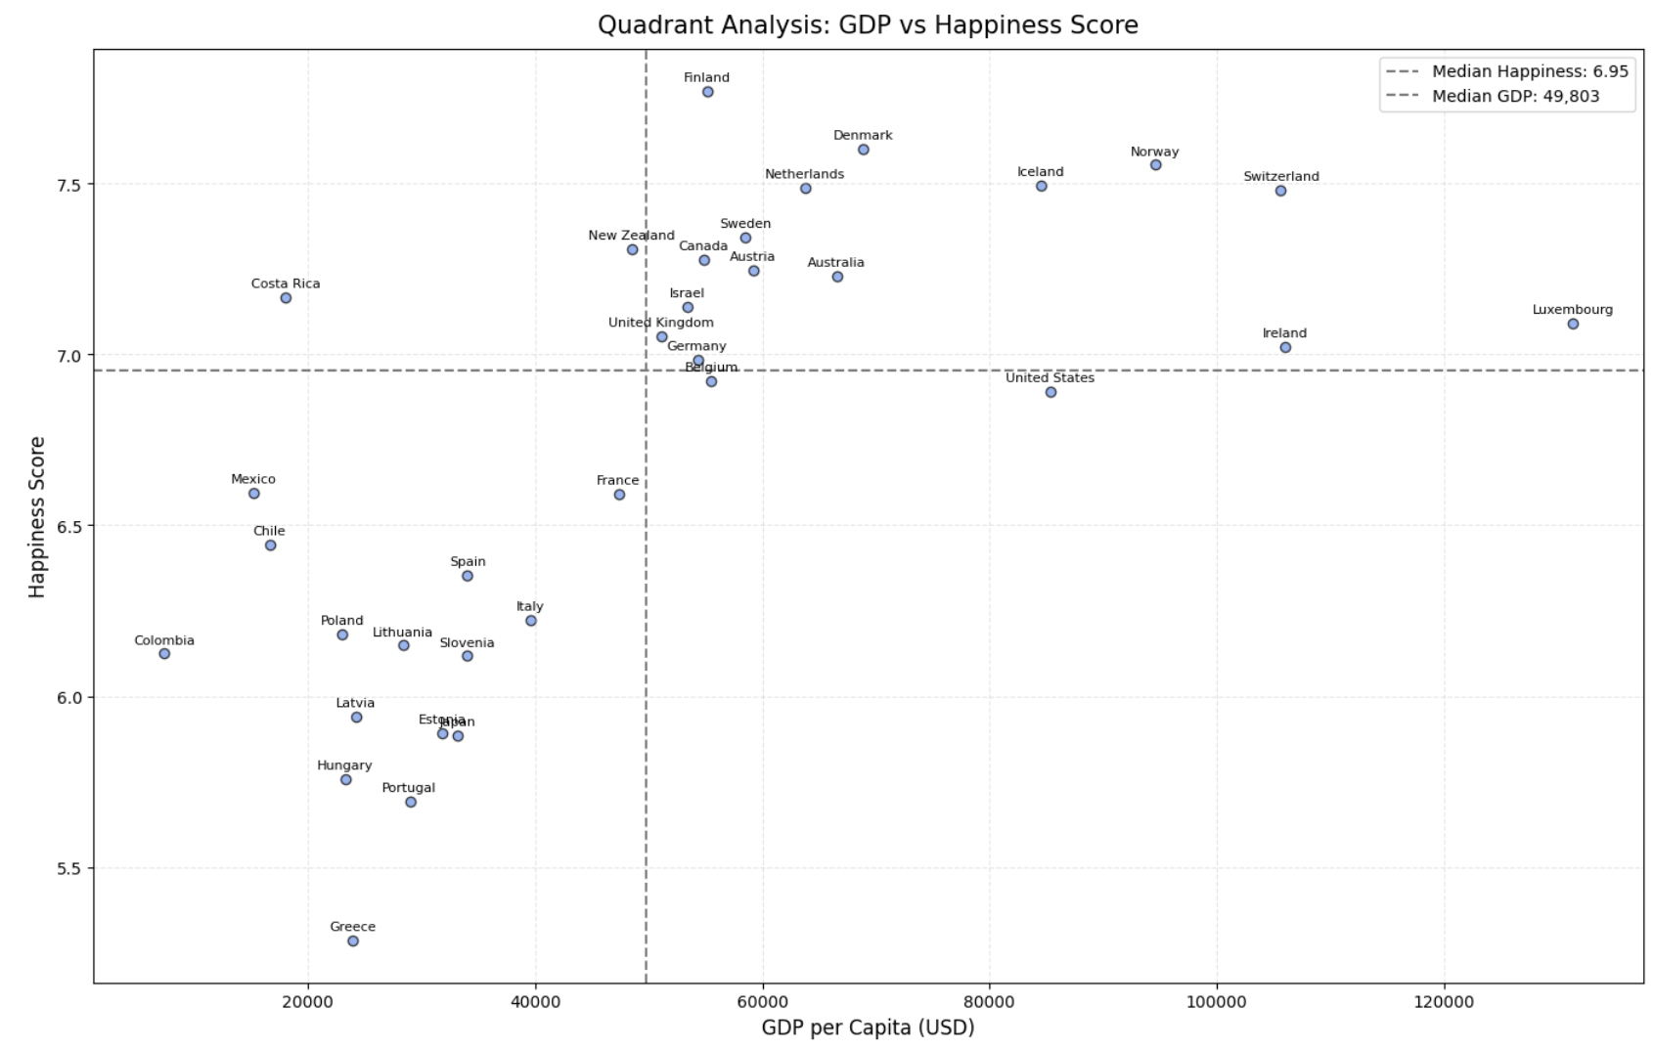
Quadrant Analysis of GDP vs. Happiness Score
Top right quadrant = High GDP and High Happiness
Bottom left quadrant = Low GDP and Low Happiness
Outlier: Costa Rica has low GDP, but high happiness level

Slide 6
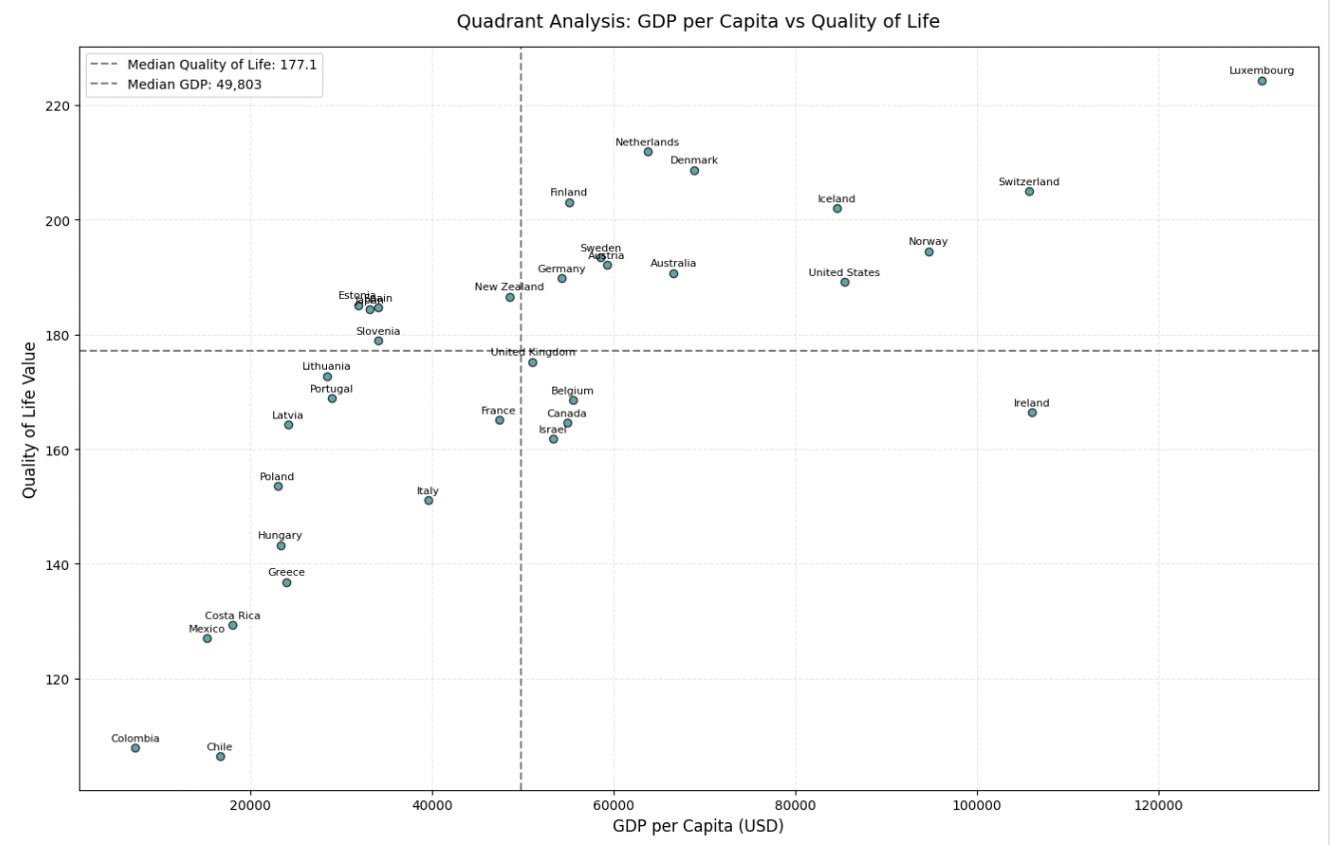
Quadrant Analysis of GDP vs. Quality of Life
Top right quadrant = High GDP and High Quality of Life
Bottom left quadrant = Low GDP and Low Quality of Life
Outlier: Ireland has high GDP, but lower quality of life

Slide 7
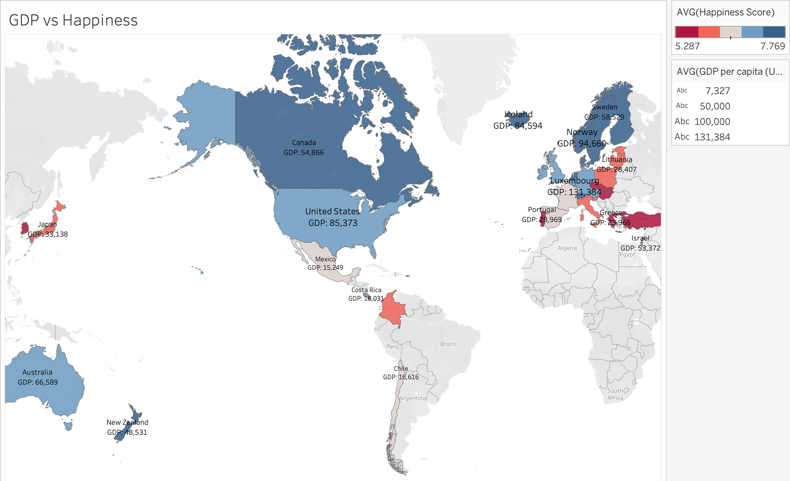
Geomap of GDP vs. Happiness Across Countries
Blues = Above average happiness score
Reds = Below average happiness score
Pink-gray = Average happiness score
Outliers: Costa Rica, Mexico, and Chile

Slide 8
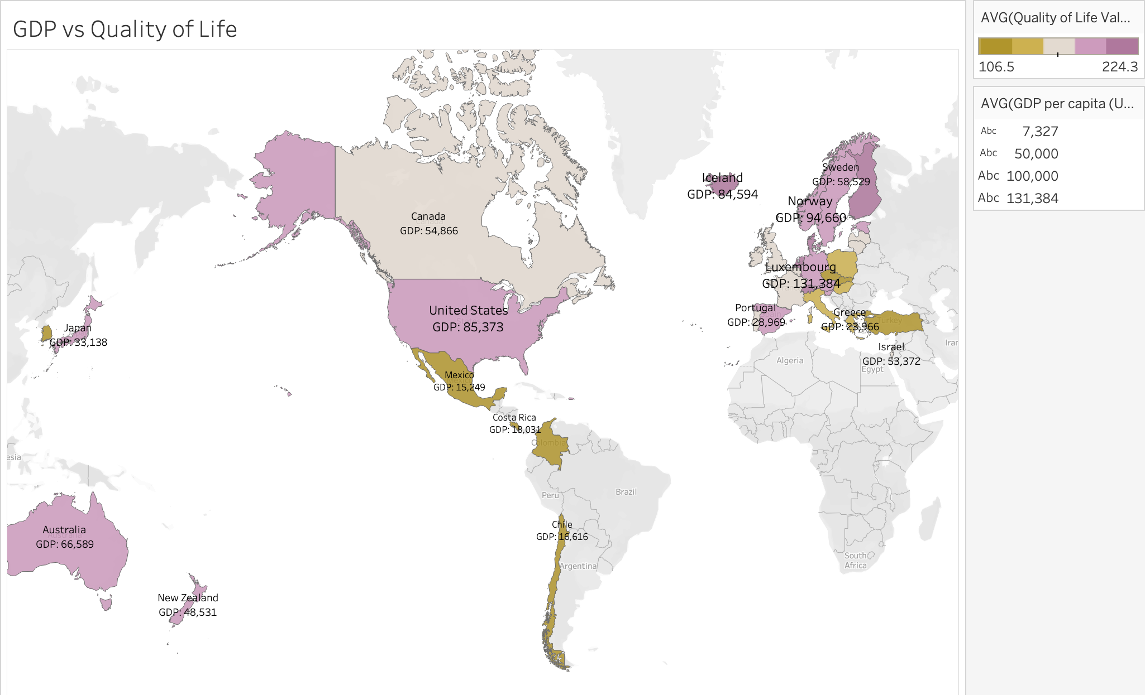
Geomap of GDP vs. Quality of Life Across Countries
Purples = Higher than average quality of life value
Golds = Below average quality of life value
Sand-grey = Average quality of life value
Outliers: Japan, Portugal, and Israel

Slide 9
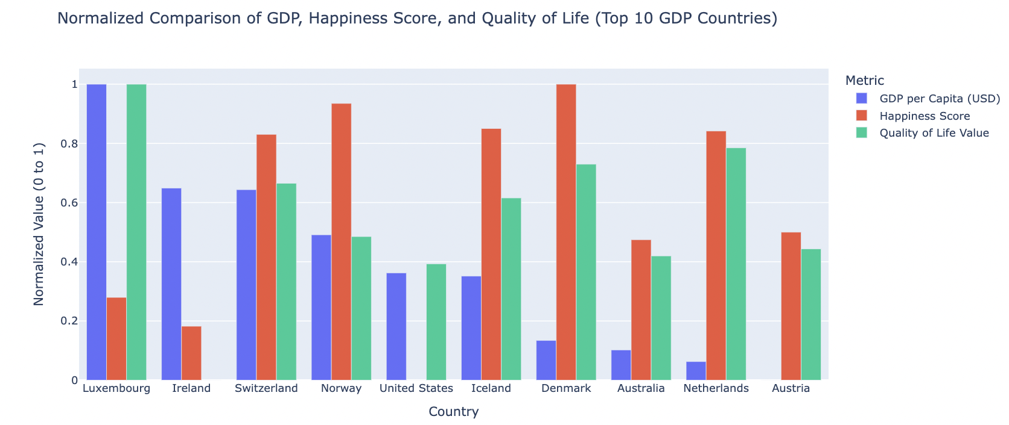
Grouped Bar Chart of Top 10 GDP Countries
Normalized values of GDP, Quality of Life, and Happiness for top 10 countries by GDP
Luxembourg: High GDP and Quality of Life, but low Happiness
Denmark: Lower GDP, but has the highest Happiness score
GDP does not guarantee higher happiness
Notes:
Values were normalized to compare variables on completely different scales.

Slide 10

Conclusion
Hypothesis is mostly supported:
Higher GDP tends to correlate with higher Quality of Life and Happiness
Norway, Australia, Iceland, Switzerland
Outliers show that economic wealth is not the only factor
Other Factors: Safety, Education, Environmental Conditions, Healthcare Access
Happiness is self-reported, so it could be biased

Slide 11

Thank you

